Slide 1
Handling of security-relevant research according to the recommendations of the German Research Foundation (DFG) and Leopoldina

Slide 2
Table of Contents
  Information about DFG and Leopoldina
  Security-relevant research
        Background, definition
        Recommendations for handling security-relevant research
  Joint Committee on the Handling of Security-Relevant Research
        Objective, tasks, and results
        Key questions for the ethical assessment of security-relevant research
        Case studies illustrating security-relevant research
  Framework for security-relevant research
        Legal framework
        Funding of security-relevant research
  Summary and outlook

Slide 3
1
Information about DFG
and Leopoldina

Slide 4

The German Research Foundation (DFG)
is the central self-governing organisation of the sciences in Germany
competitively selects excellent research projects for funding
advises politics and society
its members: research-intensive universities, non-university research organisations, scientific associations and the academies of sciences and humanities

Slide 5
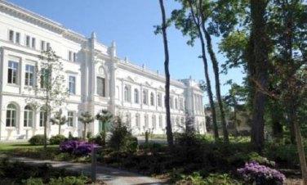
Leopoldina
Founded in 1652 as Academy of Sciences
Approx. 1,600 members from more than 30 countries
National Academy of Sciences: Advises politics and society, represents German science internationally
Committed to the common good and independent of economic and political interests
Head Office of Leopoldina since 2008, Halle/Saale

Slide 6
2
Security-relevant research

Slide 7
The “dual-use dilemma”
Free research
Essential for scientific progress
Developing scientific questions and approaching them independently; free exchange of information …
Protected by the German Basic Law (Grundgesetz)
Research risks
unintended adverse consequences
"Misuse" of research results and methods by third parties (attack, defence, crime, terror, suppression ...)
What are the boundaries of research?
Who determines these boundaries and how?
Who enforces these boundaries?

Slide 8
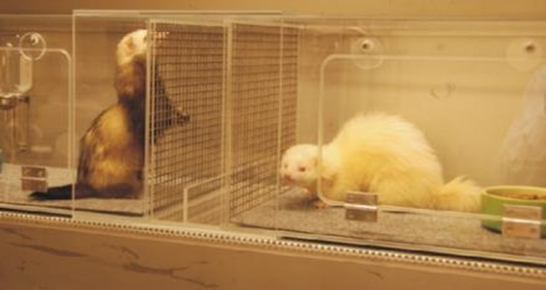
Security-relevant research of concern
Herfst, S. et al. (2012). Airborne Transmission of
Influenza A/H5N1 Virus Between Ferrets. Science
336(6088): 1534-1541.
Imai, M. T. et al. (2012). Experimental adaptation
of an influenza H5 HA confers respiratory droplet
transmission to a reassortant H5 HA/H1N1 virus in
ferrets. Nature 486(7403):420-428.
Caused a global outcry with multiple implications:
Global moratorium on gain of function (GoF) research on influenza 2011 – 2012
NIH funding pause for GOF research on influenza, SARS and MERS 2014 – 2017
Re-evaluation of laboratory biosafety standards
Impetus for the establishment of the Joint Committee in Germany in 2015

Slide 9
Security-relevant research of concern
“Security-relevant research of concern is scientific research work that has the potential to produce knowledge, products or technologies that could be directly misused by third parties to cause significant damage to human dignity, life, health, autonomy, property, the environment or peaceful coexistence.” (Joint Committee on the Handling of Security-Relevant Research, 3 September 2019)

Slide 10
DFG and Leopoldina on the self-regulation of the sciences
The sciences themselves should develop ethical principles as well as mechanisms for the responsible handling of research freedom and research risks
Flexible and factual self-regulation
Additional legal regulations can address the risks of free research only to a limited extent

Slide 11

Recommendations for Handling of Security-Relevant Research
Dual-use issues apply to virtually all areas of scientific research:
Artificial intelligence to identify and eliminate software vulnerabilities: A tool for criminal hackers?
Materials research and nanotechnology: weapons of attack?
Virus research: bioweapons for terrorist attacks?
Nuclear research: Weapons of mass destruction?
Industrial robot research: Construction of war drones?
Behavioural research on the radicalisation of terrorist assassins: New recruitment strategies?
...
DFG & Leopoldina 2014
Updated 11/2022

Slide 12
Recommendations for Handling of Security-Relevant Research
Observance of ethical principles by researchers beyond legal rules
Risk analysis
Risk minimisation
Documentation and communication of risks
Risk of publication
Training, education and awareness raising
Clarity about who is responsible
Availability of compliance bodies
Definition of ethics rules by research institutions
Establishment of advisory committees for ethics in security-relevant research (KEF)
Directed at individual researchers
Directed at research institution

Slide 13
3
Joint Committee on the Handling of Security-Relevant Research

Slide 14
Tasks of the Joint Committee of DFG and Leopoldina
Promote and monitor the implementation of the recommendations at the research institutions
Support implementation, especially the establishment and work of the KEFs
Act as a contact for the KEFs and a platform for the pooled exchange of experience
Responsibility for the discussion of individual cases should generally lie with the respective research institution
In special cases, ad-hoc working group of Leopoldina for a risk-benefit assessment and recommendations possible

Slide 15
Members of the Joint Committee (updated 2020-03)
Stephan Becker, University of Marburg, Institute of Virology
Alfons Bora, University of Bielefeld, Faculty of Sociology
Una Jakob, Peace Research Institute Frankfurt, Frankfurt am Main
Frank Kirchner, German Center for Artificial Intelligence, Bremen
Anika Klafki, FSU Jena, Faculty of Law
Felicitas Krämer, University of Potsdam, Institute of Philisophy
Florian Kraus, University of Marburg, Department of Chemistry
Thomas Lengauer, MPI for Informatics, Saarbrücken
Lars Schaade, Robert Koch Institute Berlin
Britta Siegmund, Charité Universitätsmedizin Berlin
Judith Simon, University of Hamburg, Chair of Ethics in Information Technology
Jochen Taupitz, University of Mannheim, Faculty of Law and Economics

Slide 16
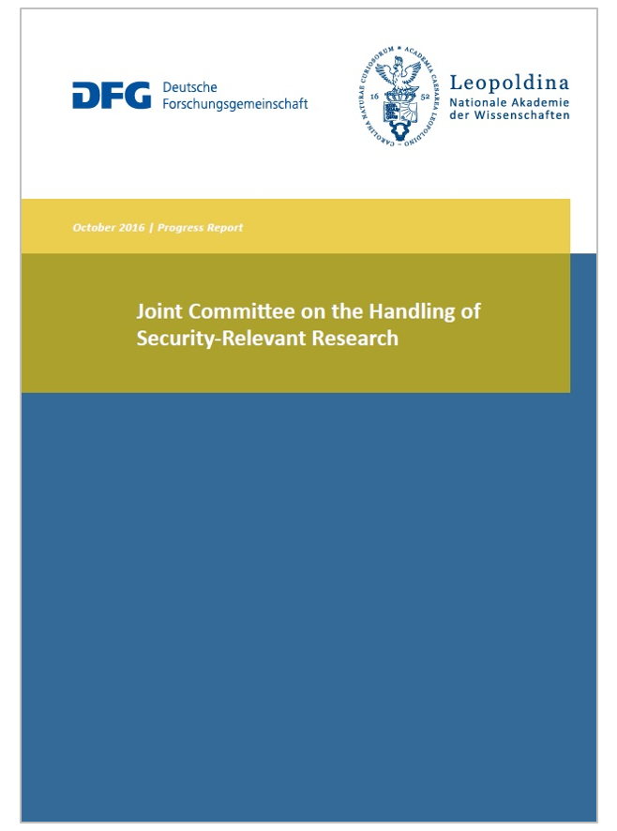
Model statutes for Committees on Ethics in Security-Relevant Research (KEF)
§ 1 Committee for Ethics in Security-Relevant Research
§ 2 Responsibilities and foundations of the work of the KEF
§ 3 Composition and members
§ 4 Legal status of the KEF and its members
§ 5 Management
§ 6 Initiating proceedings
§ 7 Proceedings
§ 8 Decision-making procedure
§ 9 Notification of unexpected risks and security-relevant aspects
§ 10 Fees/remuneration and compensation
§ 11 Concluding provisions
1st Progress Report of the JC 2016

Slide 17
Contact persons and committees for handling security-relevant research

Slide 18
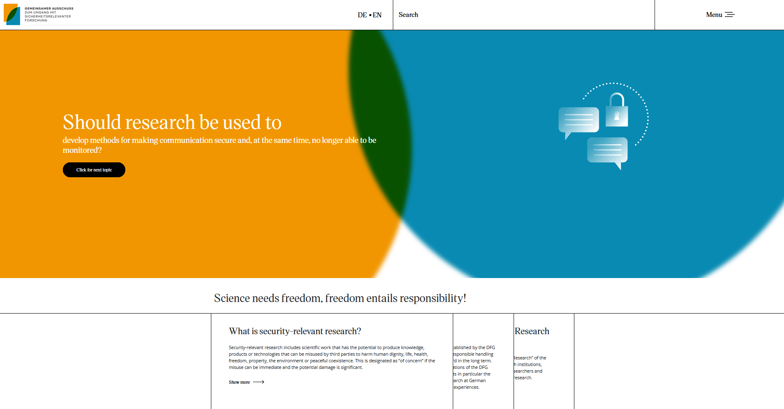
Website of the Joint Committee
www.security-relevant-research.org

Slide 19
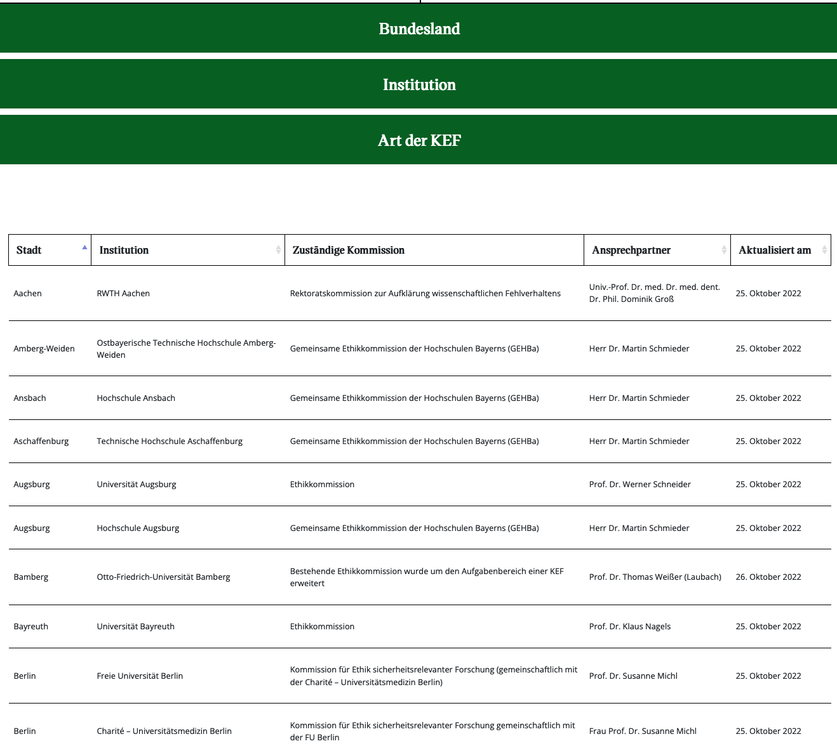
Website of the Joint Committee
> 150 entries by:
Universities, non-university research institutions and organisations, departmental research institutions, professional societies and one industry association
> 100 Committees on Ethics in Security-Relevant Research (KEF)
www.security-relevant-research.org/contactpersons/

Slide 20
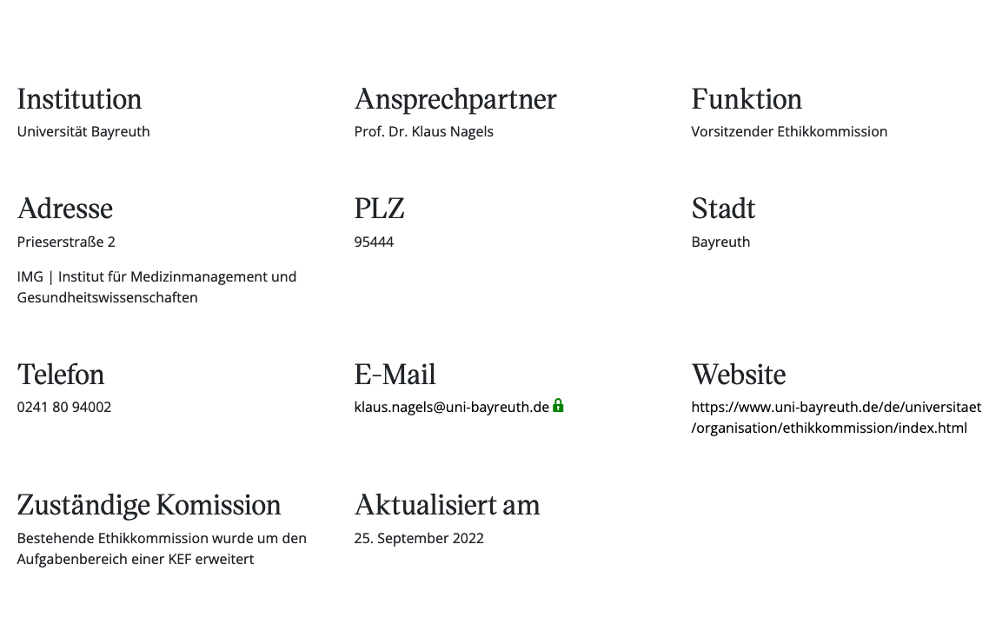
Website of the Joint Committee
www.security-relevant-research.org/contactpersons/

Slide 21
Events of the Joint Committee
11/2014: Scientific Freedom and Scientific Responsibility – Do the chances of success justify the risks? (Halle)
04/2016: Information event on the implementation of the DFG and Leopoldina recommendations (Berlin)
10/2017: Freedom and responsibility in computer science (Darmstadt)
06/2018: KEF Forum (Berlin)
04/2019: Discussion evening "Security instead of Freedom” (Berlin)
07/2019: Student workshop „Risk Governance and the Role of Science and Humanities” (Potsdam)
07/2019: The mystery of risks – How can science help reconcile perception and assessment? (Potsdam)
09/2019: KEF-Forum at the Friedrich Loeffler Institute (Riems Island)
05/2021: Opportunities and risks of chemistry research (online)
10/2021: Biometrics and personal rights (Hannover)
04/2022: KEF Forum at the German Electron Synchrotron (DESY) (Hamburg)
05/2023: Brain-Computer Interfaces: Will the Boundaries between Man and Machine Soon Blur? (Hanover)
06/2023: Raising awareness and building competencies for ethics of security-relevant research (dual use) in teaching – theories, methods, good practices (Berlin)

Slide 22
Joint Committee surveys on the work of the KEFs
Aim of the surveys (2016/17; 2018/19; 2020/21):
Overview of the status of implementation of the recommendations “Scientific Freedom and Scientific Responsibility“
Strengthening discussion and exchange between research institutions and the Joint Committee
Improving assistance by the Joint Committee
Questions about:
Responsibilities for security-relevant research
Working methods and composition of the committees
Cases discussed and justifications for respective votes
Awareness-raising measures on security-relevant research

Slide 23
Feedback from the contact persons on the handling of security-relevant research
Feedback from the contact persons on the handling of security-relevant research(N=157) 11.10.2023

Slide 24
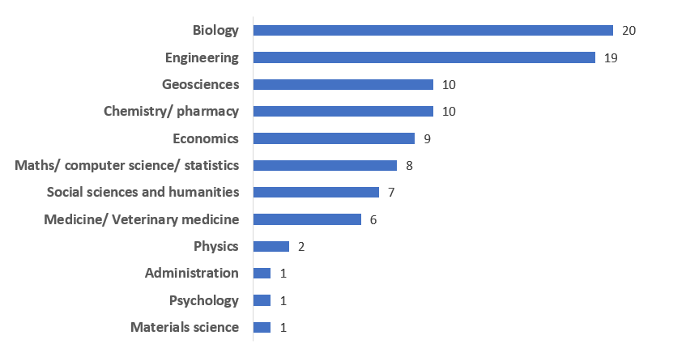
Feedback from the contact persons on the handling of security-relevant research
Between 2016 and 2021, a total of 94 potentially security-relevant cases were discussed in the KEFs

Slide 25
94 advisory votes of the KEFs (2016 – 2021)
Approved (66x): purely basic research, clear benefit to civil society expected or potential for misuse lower than for beneficial application, adequate ethical monitoring secured
Conditionally approved (21x): Educational measures, regulation of public relations, regular reporting to the KEF, further preventive requirements for risk reduction (e.g. cooperation agreement, improved data security, regular independent review).
Negative votes (7x): Danger of dissemination of anti-constitutional information, no recognisable civilian benefit, military connections of a participating scientist from an authoritarian regime, sponsor with military connection and lack of clarity about non-disclosure obligations, violation of self-commitment (civil clause) of the research institution, indirect promotion of petroleum & natural gas exploration through necessary data purchase

Slide 26
Recommendations for anchoring security-relevant research in teaching and education
Bachelor's degree courses: interdisciplinary overview courses on "good scientific practice" with reference to dual-use.
Master‘s programmes: subject-specific seminars on ethical issues and security-relevant cases in one's own discipline
Doctoral students & post-docs: staff training, summer schools, graduate schools for specific risks in research

Slide 27
Recommendations for anchoring security-relevant research in teaching and education
Good-Practice (winter term 2019/20 and summer term 2020):
University of Tuebingen: Bachelor of Science Biology: compulsory module Bioethics (3rd semester, lecture and seminars)
University of Wuerzburg: Seminar: "Legal and Ethical Aspects in Life Sciences"
TU Munich: Seminar „Ethics for Nerds“ for computer science students, case studies will be used to discuss the dangers of information technology research
TU Hamburg-Harburg: Seminar “Acting responsibly in technology and science” for engineering students

Slide 28
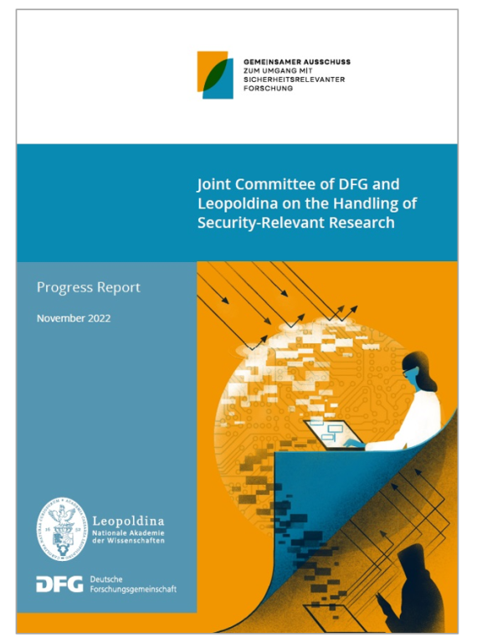
Progress Report of the Joint Committee (11/2022)
Key points:
Case studies
How the German sciences deal with security-relevant research
Funding conditions for security-relevant research
Export control in science
Guiding question for the ethical evaluation of security-relevant research
Recommendations for raising awareness
International and national debates on security-relevant research
www.security-relevant-research.org/publication-progressreport2022

Slide 29

Information Brochure of the Joint Committee (04/2022)

Slide 30
Key questions for the ethical assessment of security-relevant research

Slide 31
1. Key questions for researchers indicating that they need to consult a KEF
1.1 Is it likely that your research project is security-relevant research according to the above-specified meaning and/or the above-mentioned contexts?
1.2 Is it possible that cooperation partners involved in your research project will cause security-relevant risks in the above-mentioned meaning?
1.3 Does the research project conflict with legal regulations¹ and thus needs to be referred to a compliance office alongside a KEF?
¹ E.g. regular criminal law, export control legislation and export provisions of the German Federal Office of Economics and Export Control (BAFA), the Biological Weapons Convention and the Chemical Weapons Convention, the protection of human rights, humanitarian international law, rules of war, prohibition of torture and violence, Biodiversity Convention.

Slide 32
2. Key questions for processing the query by the KEFs
2.1 What concrete objectives and purposes are the researchers and any sponsors involved pursuing with this research project?
2.2 Is the required expertise available to make an informed assessment of the research project in regard to its potential risks or does additional expertise need to be brought in?
2.3 Is it possible to adequately specify and weigh up the benefits and risks of the known and potential research findings with the information currently available?
2.4 Are the security-relevant outcomes and resulting risks of the research project new or could they also arise from previously published work?

Slide 33
2. Key questions for processing the query by the KEFs
2.5 How likely is it that the security-relevant findings will be disseminated and that this will lead to a direct¹ concrete misuse in the above-specified meaning of security-relevant research of concern?
2.6 In the event of an intentional harmful application of the findings through third parties, what would be the scale of the potential damage and are any suitable countermeasures² available?
2.7 What are the potential harmful consequences³ of not carrying out the research project?
¹ To be considered here are e.g. the necessary capabilities, specialist knowledge and technical equipment for misuse.
² E.g. measures of recovery and traceability and damage limitation.
³ Can the absence of certain innovations result in additional damage, for example, in the course of ongoing military conflicts, in the course of climate change, in naturally emerging waves of infection?

Slide 34
3. Key questions for the conclusive assessment and consultation by the KEFs
3.1 Can the research project produce knowledge, products or technologies that could very likely be misused directly by third parties to cause significant damage of the above-specified legal interests?
3.2 Should the project be reassessed by the KEF at a more advanced stage when the security-relevant risks can be judged more easily?
3.3 Are the research project and its objectives and purposes compatible with the constitutional principles and the basic code or guidelines of the research institution?
3.4 Can the security-relevant risks be sufficiently reduced by imposing certain conditions on the project (e.g. usage agreement or alternative research strategy) or by adapting the publication?
3.5 How can the researchers involved in the research project be made aware of the ethical aspects of security-relevant research so that they consider the direct and future consequences of their work?

Slide 35
Case studies for security-relevant research of concern

Slide 36

Example I: Production of mutated variants of the avian influenza virus
Aim: Identification of mutations that make naturally occurring
variants of the virus more transmissible between mammals.
Result: Production of virus variants that are more airborne transmissible between mammals (ferrets) than the wild type
Benefit: Better preparation for potential pandemics
Risk: Virus variants could escape from high-security laboratories through negligence? Construction manual for a bioweapon for terrorism or biological warfare?
Original studies: Herfst, Fouchier et al. (2012) Airborne Transmission of Influenza A/H5N1 Virus Between Ferrets. Science
Imai, Kawaoka et al. (2012) Experimental adaptation of an influenza H5 HA confers respiratory droplet transmission to a reassortant H5 HA/H1N1 virus in ferrets. Nature

Slide 37

Example II: AI methods for the detection and elimination of software vulnerabilities
Aim: Automatic detection of vulnerabilities in computer software,
especially in operating systems of routers, smartphones and laptops
using AI methods in order to develop targeted defense measures.
Result: Vulnerabilities in numerous devices are identified
Benefit: Improvement in the security of devices possible; protection against hacker attacks
Risk: Exploitation of AI method by criminals to improve malware? Access to sensitive information and the potential for blackmail?
See Review: Brundage, M., Avin, S., & Clark, J. (2018). The malicious use of artificial intelligence: forecasting, prevention, and mitigation. Future of Humanity Institute, University of Oxford, Centre for the Study of Existential Risk, University of Cambridge. Center for a New American Security, Electronic Frontier Foundation, Open AI.

Slide 38
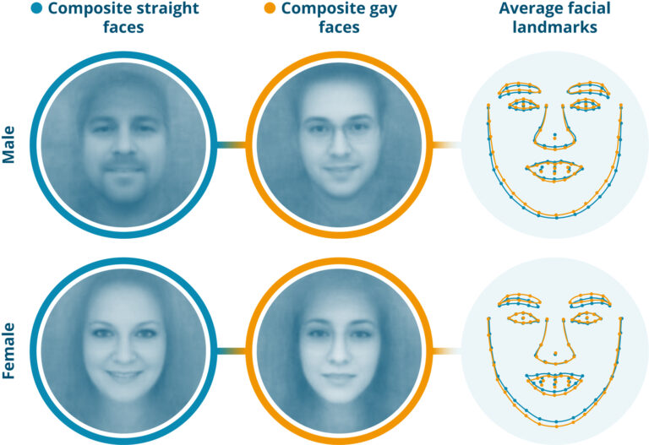
Example III: Predicting people's sexual orientation using deep learning algorithms
Aim: Further development of a deep-learning algorithm for pattern
recognition in portrait photos
Result: Trained algorithm can predict sexual orientation from portrait photos with high success rate
Benefit: Improved knowledge about the mechanism of deep learning algorithms and about the limits of human perception.
Risk: Unlawful acquisition of sensitive personal information using biometric data? *Homosexuality is punishable in some countries
Original study: Wang und Kosinski (2017) Deep neural networks are more accurate than humans at detecting sexual orientation from facial images. PsyArXiv

Slide 39
Example IV: Production of synthetic, infectious poxviruses
Aim: Synthetically producing known viruses with large genomes
Result: Using synthetic DNA and cells infected with a harmless rabbit virus, infectious equine pox viruses are produced
Benefit: Development and realisation of a complex synthesis process; basis for the development of vaccines
Risk: Production of human-pathogenic infectious smallpox viruses?
*Pox has been eradicated and good vaccines are available
Original study: Noyce, Lederman und Evans (2018) Construction of an infectious horsepox virus vaccine from chemically synthesized DNA fragments. PLoS One

Slide 40

Example V: Extracting sensitive information via brain-computer interfaces
Aim: Determining the brain regions used for numbers, images and
geodata by means of EEG and to train the interface with measurement data
Result: Reliability of the extracted data improves
Benefit: Enabling or improving communication and interaction of physically impaired persons with humans and machines
Risk: Unlawful extraction of sensitive information, e.g. passwords or bank data using harmless stimuli
Original study: Martinovic, I., Davies, D., Frank, M., Perito, D., Ros, T., & Song, D. (2012). On the feasibility of side-channel attacks with brain-computer interfaces. In 21st {USENIX} Security Symposium ({USENIX} Security 12) (pp. 143-158).

Slide 41
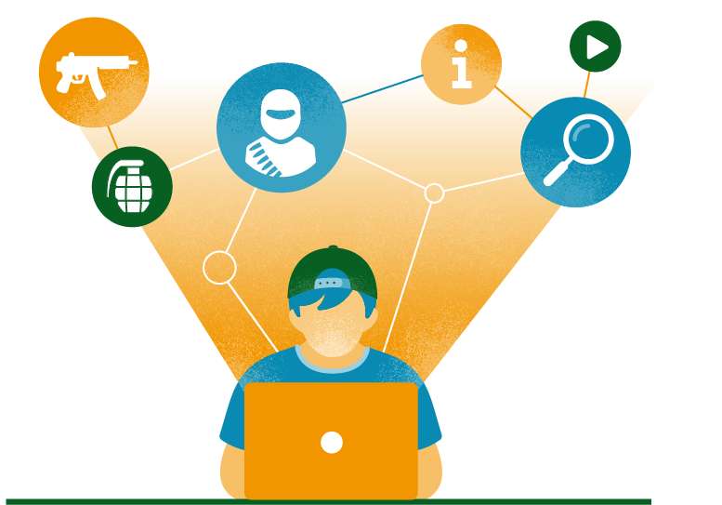
Example VI: Exploring pathways to radicalisation
Aim: Identifying the link between consumption of extremist
content on the internet and the associated radicalisation
Result: Determining which groups of people are particularly susceptible to which type of media information
Benefit: Development of strategies for deradicalisation
Risk: Terrorist groups could use the knowledge to develop more effective recruitment methods
See: Frissen, T. (2021). Internet, the great radicalizer? Exploring relationships between seeking for online extremist materials and cognitive radicalization in young adults. Computers in Human Behavior, 114, 106549.
Notes:
Erforschung von Wegen der Radikalisierung – Rekrutierungshilfe für Terrorgruppen?
Die Studie erforscht den Zusammenhang zwischen dem Konsum extremistischen (islamistischen) Materials im Internet durch Jugendliche und damit verbundene Radikalisierung. Frühere Forschung hat bereits die große Bedeutung des Internets für die Verbreitung radikalisierenden Materials aufgezeigt. Hier wird zusätzlich untersucht, welche Eigenschaften Zielpersonen in dieser Hinsicht besonders anfällig machen und welche Kanäle sowie Medien besonders wirksam sind. So ergibt sich etwa, dass Videomaterial von Enthauptungen unter den Jugendlichen zwar am populärsten ist, aber ein geringes Radikalisierungspotential hat. Demgegenüber werden Online-Magazine des sogenannten Islamischen Staats und von Al-Qaida nur von Wenigen gesucht, haben aber den größten kognitiven Effekt. Hieraus sollen Erkenntnisse für Strategien der Deradikalisierung gewonnen werden. Gleichzeitig könnten die Ergebnisse in effektivere Rekrutierungsmethoden von extremistischen und terroristischen Gruppen einfließen.
Originalarbeit: Frissen, T. (2021). Internet, the great radicalizer? Exploring relationships between seeking for online extremist materials and cognitive radicalization in young adults. Computers in Human Behavior, 114, 106549.

Slide 42
4
Framework for security-relevant research

Slide 43
International legal framework for security-relevant research
Regulation (EU) 2021/821 setting up a Union regime for the control of exports, brokering, technical assistance, transit and transfer of dual-use items
Biological Weapons Convention (BWC) and Chemical Weapons Convention (CWC) (Prohibition of the production, stockpiling and use of biological and chemical weapons)
Hague Ethical Guidelines by the Organisation for the Prohibition of Chemical Weapons (OPCW) to promote a culture of responsible conduct in the chemical sciences and to guard against the misuse of chemistry

Slide 44

National legal framework for security-relevant research
Regular criminal law
German Biological Agents Ordinance (Biostoffverordnung)
German Genetic Engineering Act (Gentechnikgesetz)
German Infectious Diseases Protection Act (Infektionsschutzgesetz)
German War Weapons Control Act (Kriegswaffenkontrollgesetz)
Export regulations of the Federal Office of Economics and Export Control (BAFA, see also „Export Control and Academia Manual“)
...

Slide 45
Part 1 Section A: military items (weapons, ammunition and armament materials) whose export and/or intra-EU transfer always requires authorisation
"Biological agents ... selected or modified to increase effectiveness in incapacitating humans or animals ...“
Part 1 Section B: national list with dual-use items whose export to certain countries requires authorisation (e.g. fermenters, coating manifacturing equipment, certain software, IT equipment)
Basic scientific research: experimental or theoretical work mainly to obtain new information on fundamental principles of phenomena or facts which are not primarily aimed at a specific practical goal or a specific practical purpose
www.bafa.de/SharedDocs/Downloads/EN/Foreign_Trade/ec_academia.pdf?__blob=publicationFile&v=5

Slide 46
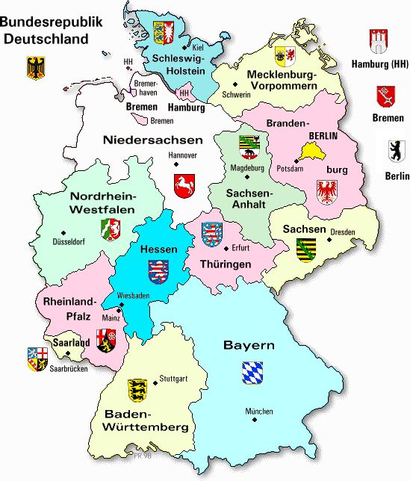
References to security-relevant research in state higher education legislation
Mecklenburg-Western Pomerania and Saxony-Anhalt: restrict freedom of research with reference to “responsibility towards people, society and nature”
Bremen, Thuringia and Hesse: need for responsible handling of security-relevant research
Schleswig-Holstein and Lower Saxony: Senate commissions for research ethics are mandatory

Slide 47

Funding of security-relevant research
In the EU Framework Programme for Research and Innovation, ethical self-evaluation with regard to risks of misuse is obligatory when submitting applications
Establishment of advisory committees for corresponding ethical questions recommended
DFG asks applicants to review their project with regard to security-relevant risks and, if necessary, to comment on the risk-benefit ratio and risk minimisation measures
If KEF exists -> KEF statement to be attached to the DFG funding proposal

Slide 48
Reference in the DFG-Guidelines for Safeguarding Good Research Practice (updated 07/2019)
Guideline 10: Legal and ethical frameworks, usage rights:
„Researchers adopt a responsible approach to the constitutionally guaranteed freedom of research. They comply with rights and obligations, particularly those arising from legal requirements and contracts with third parties, and where necessary seek approvals and ethics statements and present these when required. With regard to research projects, the potential consequences of the research should be evaluated in detail and the ethical aspects should be assessed. […]“
Explanations:
„[…] They pay particular attention to the aspects associated with security-relevant research (dual use). HEIs and non-HEI research institutions are responsible for ensuring that their members’ and employees’ actions comply with regulations and promote this through suitable organisational structures. […]“

Slide 49
5
Summary and outlook

Slide 50
Summary and outlook
DFG and Leopoldina acknowledge the special responsibility of the sciences in dealing with security-relevant risks in research
In principle, security-relevant risks conseivable in all scientific fields
Further legal instruments are not appropriate at present
Awareness of risks among researchers is of particular importance (in teaching as well as ongoing scientific work)
Approx. 120 research institutions/organisations throughout Germany have committees or representatives responsible for the ethical evaluation of security-relevant research available
Joint Committee will continue to monitor, support and coordinate the self-organisation of the scientific community (maintaining contact, lectures, workshops, website, progress reports...)

Slide 51
Office of the Joint Committee and cooperation partners
Office at Leopoldina: Dr. Johannes Fritsch
Dr. Anita Krätzner-Ebert Lena Diekmann
Contact persons DFG: Dr. Ingrid Ohlert
Dr. Christian Bamann
Cooperation partners: Leopoldina (leading)
DFG (leading)
Leibniz-Gemeinschaft
Helmholtz-Gemeinschaft
Fraunhofer-Gesellschaft
Max-Planck-Gesellschaft
Contact: gemeinsamer-ausschuss@leopoldina.org
Website: www.security-relevant-research.org

